Slide 1
Incitement of Imminent Lawless Action
LSU Media Law Class
+Allen Alongi
+Wendy Bradford
+Lauren Miclette
+Becca Weger

Slide 2
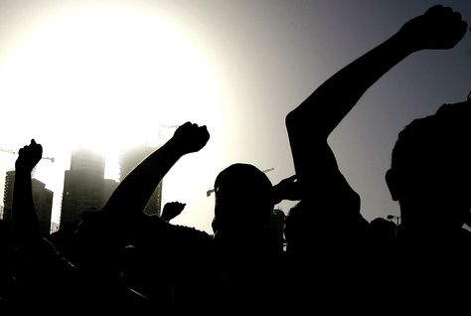
What is Incitement of Imminent Lawless Action?
Photo by: aribianbusiness.com
+ What is incitement?
+ What is imminent lawless action?
Notes:
WENDY

Slide 3
Brandenburg vs. Ohio
Photo by: cases.laws.com
Photo by: realmagik.com
+ “revengence” speech
Notes:
ALLEN

Slide 4
Braun vs. Soldier of Fortune Magazine
Photo by: kotaku.com
+ hit man for hire
Notes:
ALLEN
SOF Published the following ad:
3 GUN FOR HIRE: 37 year old professional mercenary desires jobs. Vietnam Veteran. Discrete [sic] and very private. Body guard, courier, and other special skills. All jobs considered. Phone (615) 436-9785 (days) or (615) 436-4335 (nights), or write: Rt. 2, Box 682 Village Loop Road, Gatlinburg, TN 37738.

Slide 5
Incitement of Imminent Lawless Action Worksheet
Notes:
BECCA

Slide 6
Incitement of Imminent Lawless Action Worksheet
A student makes fun of someone who is short in the hall at school.
A student sends a text message to everyone in school telling them to make fun of all short people on May 8.
A student in your class adds you as a friend on Facebook.
A student creates a Facebook group to make fun of all tall people at school the next day.
Notes:
BECCA

Slide 7
Incitement of Imminent Lawless Action Worksheet
A student makes fun of someone who is short in the hall at school.
A student sends a text message to everyone in school telling them to make fun of all short people on May 8.
A student in your class adds you as a friend on Facebook.
A student creates a Facebook group to make fun of all tall people at school the next day.
Notes:
BECCA

Slide 8
Incitement of Imminent Lawless Action Worksheet
A student makes fun of someone who is short in the hall at school.
A student sends a text message to everyone in school telling them to make fun of all short people on May 8.
A student in your class adds you as a friend on Facebook.
A student creates a Facebook group to make fun of all tall people at school the next day.
Notes:
BECCA

Slide 9
Incitement of Imminent Lawless Action Worksheet
A student passes a note in class.
A student passes a note to every student in class that tells everyone to scream at exactly 1:30.
A student skips class.
A student spreads word to the entire 6th grade to skip class on January 12.
Notes:
BECCA

Slide 10
Incitement of Imminent Lawless Action Worksheet
A student passes a note in class.
A student passes a note to every student in class that tells everyone to scream at exactly 1:30.
A student skips class.
A student spreads word to the entire 6th grade to skip class on January 12.
Notes:
BECCA

Slide 11
Incitement of Imminent Lawless Action Worksheet
A student passes a note in class.
A student passes a note to every student in class that tells everyone to scream at exactly 1:30.
A student skips class.
A student spreads word to the entire 6th grade to skip class on January 12.
Notes:
BECCA

Slide 12
Incitement of Imminent Lawless Action and Social Media
Photo by: Cheryl Lawson
Notes:
LAUREN
Twitter, Facebook, YouTube, RSS,
WordPress, Skype, Live Journal, Digg,
Flickr, Stumble Upon, Linken In, Friend Feed

